Slide 1
JOB RECOMMENDATION SYSTEM- CAREER GUIDANCE -AI ASSISTED
210701048 - DEEPIKA SG
210701063 - GOPIKA K V

Slide 2
ABSTRACT
Developing a career guidance application powered by AI to streamline job searching for users. The application analyzes resumes submitted by users to extract key information such as skills, qualifications, and experience.Using this data, the system recommends suitable job opportunities tailored to each individual's profile. We aim to revolutionize the job search process, providing personalized recommendations that match users with roles aligned to their expertise and aspirations.Our project aims to enhance efficiency and effectiveness in career advancement, ultimately empowering users to make informed decisions in their professional journey.

Slide 3
EXISTING SYSTEM
The existing system for the career guidance application utilizes AI assistance to match job seekers with suitable opportunities based on their submitted resumes.The current system may face challenges in accurately interpreting nuanced details or adapting to evolving job market trends.

Slide 4
PROPOSED SYSTEM
The proposed system aims to address the intricate challenges encountered in resume analysis by prioritizing accuracy and ensuring the veracity of user-provided details.
The system integrates a robust solution leveraging the Random Forest algorithm.
This advanced approach involves the creation of numerous decision trees, each independently analyzing resume data. Through the application of ensemble methods, these individual analyses are then combined to yield a highly accurate assessment.
By employing such sophisticated techniques, the proposed system not only enhances the accuracy of resume evaluation but also instills confidence in the reliability of the information provided by users.

Slide 5
MODULES
Resume parsing module :This module is responsible for extracting relevant information from the resumes submitted by users. You can use tools like Scrapy or other web scraping libraries to extract data such as skills, experience, education, etc., from the resumes in various formats (e.g., PDF, Word documents).

Slide 6
MODULES
Random Forest Algorithm Module: This module implements the Random Forest algorithm, a machine learning technique, to generate accurate job recommendations. Random Forest is an ensemble learning method that builds multiple decision trees and combines their predictions to improve accuracy. It can take input from the skill matching module along with other relevant variables to predict the best job options for the users

Slide 7
MODULES
User Interface Module: This module provides a user-friendly interface for users to interact with the application. It displays recommended job positions based on the analysis of their resumes and allows users to explore further details about each job, such as job description, requirements, and application process. The UI module can be implemented using web application.

Slide 8
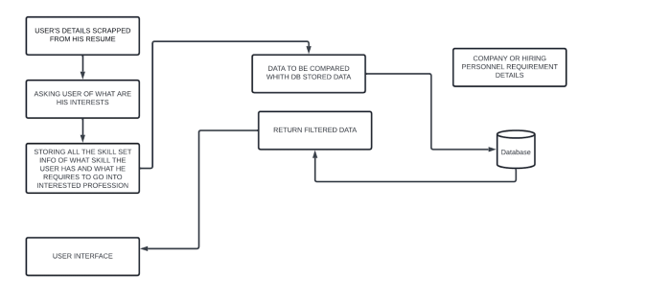
ARCHITECTURE DIAGRAM

Slide 9
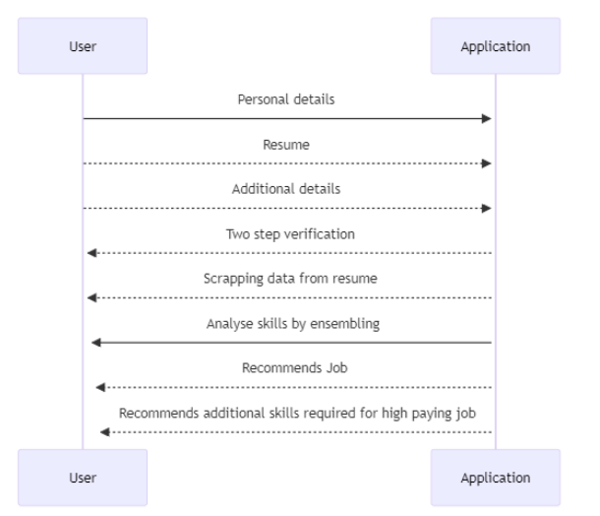
SEQUENCE DIAGRAM

Slide 10
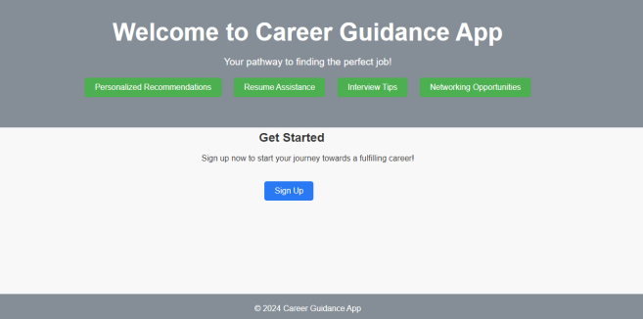
RESULT

Slide 11
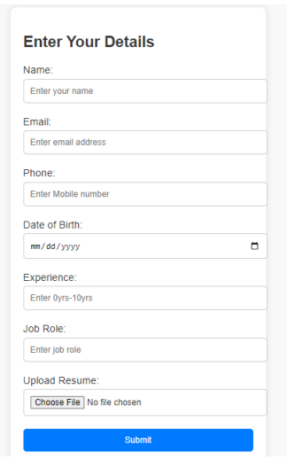

Slide 12
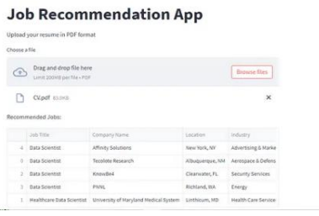

Slide 13
CONCLUSION
In summary, the creation of a job recommendation system tailored for career guidance, which utilizes user resumes to extract skills and deliver personalized job suggestions, marks a significant advancement in employment assistance. These systems amalgamate machine learning, natural language processing, and user feedback mechanisms to provide individuals with a personalized and efficient approach to job matching, enabling them to confidently navigate their career paths with greater success.

